Slide 1
Faculty of Computer Science and Information Technology
Cybersecurity Engineering
Introduction to Cybersecurity
Cloud Security
Ibrahim Can Kilic
Kyaw Min Thant
December 2022

Slide 2
Agenda
Introduction to Cloud & Cloud Security
Cloud Security Trends
How to make cloud secured?
Cloud Vulnerabilities
Cyber Attacks on Cloud
Machine Learning Solutions for Cloud Security

Slide 3
Introduction to Cloud
Cloud computing is continuous delivery of IT operations over the Internet with pay as much as you use the pricing model. By using cloud computing services, users can access, use, develop and manage several technology services such as databases, storage, and computing power.
Users can access databases, storage and computing power
AWS, Microsoft Azure, GCP
Alibaba Cloud, Oracle Cloud, and IBM Cloud

Slide 4
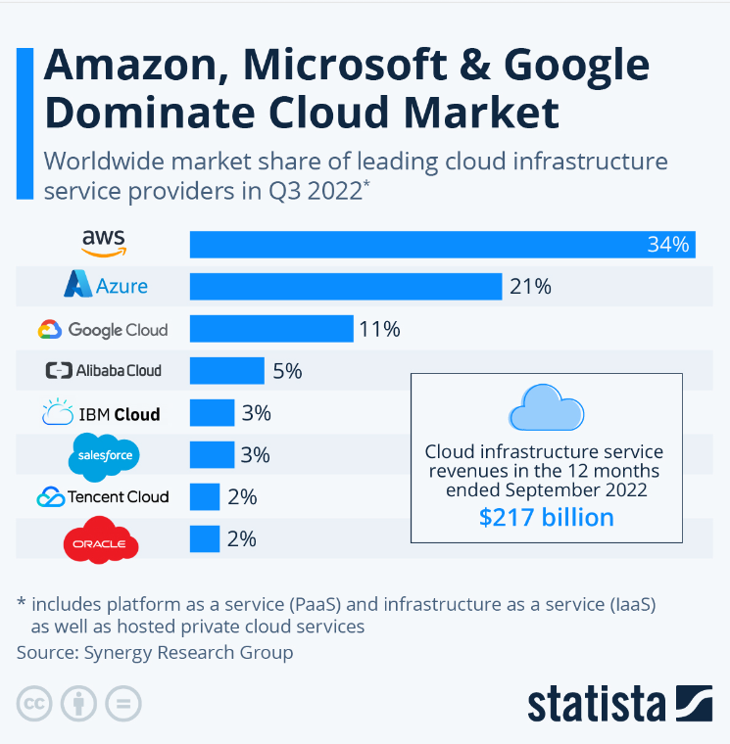
Cloud Service Companies
Cloud providers like Amazon Web Services (AWS), Microsoft Azure, Google Cloud Platform (GCP), Alibaba Cloud, Oracle Cloud, and IBM Cloud (Kyndryl) offer different solutions according to customer needs.
Most organizations continue to pursue a hybrid (39%, up from 36% last year) or multi-cloud strategy
(33%) to integrate multiple services, for scalability, or for business continuity reasons. Seventy-six
percent are utilizing two or more cloud providers.
Cloud Security Report 2022
The Covid 19 pandemic has accelerated companies' transition to cloud operations. The need for cloud computing systems is increasing day by day.

Slide 5
What is Cloud Security?
Cloud security is designed with technology, protocols, and best practices that protect cloud computing systems, applications, or websites running in the cloud, and data held in the cloud.
Technology, protocols and best practices
Protect Hardware
( Physical hardware, data storage,…)
Protect Software (Operating System, applications,…)
Cloud security is designed to protect these things; physical networks, data storage, data servers, computer virtualization frameworks, operating systems, middleware, runtime environments, data, applications, and end-user hardware

Slide 6
How to make cloud secured?
Securing the cloud can look different based on who has authority over each component, which is important to understand how these are commonly grouped.
cloud computing components are secured from two main viewpoints: cloud service types and cloud environments.
Encryption is one of the best ways to secure your cloud computing systems.
Configuration; many cloud data breaches come from basic vulnerabilities such as misconfiguration errors.

Slide 7
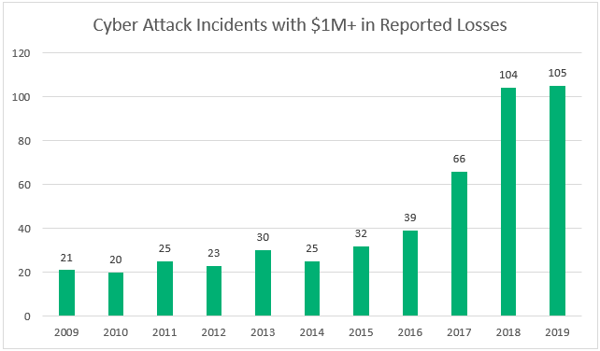
Cloud Security Trends
The Covid 19 pandemic has accelerated companies' transition to cloud operations. The need for cloud computing systems is increasing day by day.
In last decade, cyber attacks on cloud service have increased rapidly.
Cloud Computing platform is becoming the third most targeted cyber environment

Slide 8

Cloud Vulnerabilities
Misconfiguration
Insecure APIs
Lack of visibility
Lack of Multi factor Authentication
Malicious Insiders
DDoS attack

Slide 9
Misconfiguration
Many forms and shapes
Outdated SSL/TLS
One place secret secure management solution
Misconfigurations can take many forms and shapes, a few of which are public data storage, using an out-of-date version of SSL/TLS, and using one place secure secret management solution.

Slide 10

Insecure APIs
APIs are proliferating in modern software development, being used in microservices, applications, and website backends.
They must handle requests received from mobile devices, applications, webpages, and third parties, as well as bots, spammers, and hackers.
Having a secure API is critical to ensuring cyber threat mitigation and protecting against unwanted traffic.

Slide 11
Lack of Visibility
Thousands of cloud services
Easy and convenient to access
When companies are using thousands of instances of cloud services, it can be easy to get lost in them or forget about some of those running instances. Visibility into the state of your entire infrastructure must be easy and convenient to access.

Slide 12
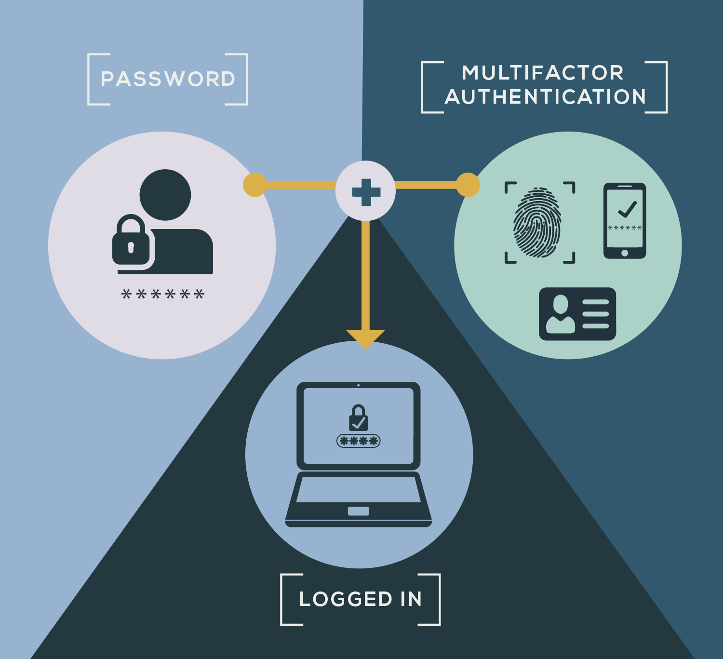
Lack of Multi factor Authentication
(MFA) is an authentication method in which a user must present at least two forms of identification validation to access an account or data.
The user is then prompted to enter a second validation, such as a one-time password/code received via SMS, email, or push notification on their cell phone.
Password and username could be vulnerable, making a lack of MFA a potentially critical vulnerability.

Slide 13
Malicious Insiders
Unauthorized access
Loose of rules
Former employees
Unauthorized access occurs when a user obtains access to some or all of company’s cloud resources. There are a few ways that these malicious insiders can gain access to your cloud accounts. One is a former employee still having valid credentials to the accounts.

Slide 14
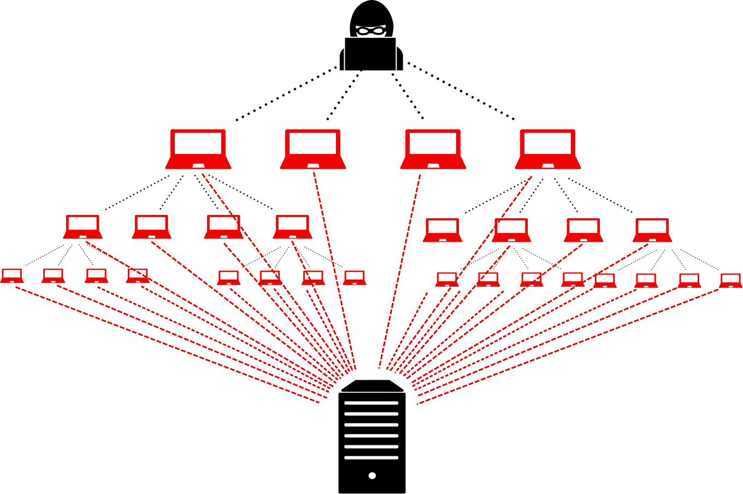
DDoS Attack
Take down the web services
Request from different sources
Unresponsive to legitimate users
(DDoS) attacks are malicious efforts to take down a web service such as a website. It works by flooding the server with requests from different sources (hence distributed) and overcharging it. The goal is to make the server unresponsive to requests from legitimate users.

Slide 15
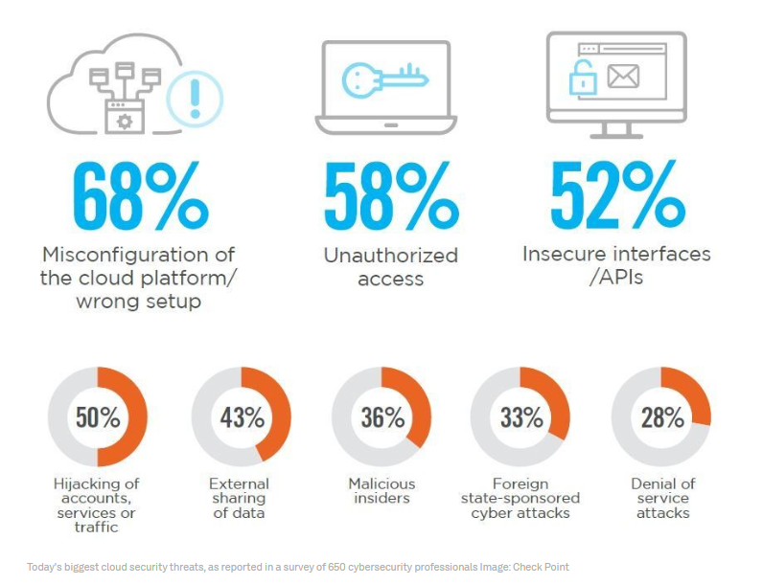
Cyber attacks on Cloud
In recent years, the number of attacks on Cloud platforms has increased rapidly. Incidentally, cloud cyber attacks accounted for 20% of all cyber-attacks in 2020, making cloud computing platforms the third most-targeted cyber environment
2020 Cloud Security Report – Check Point

Slide 16

Top Cloud Attacks in Last years
Raychat is an online chat application and customer support service that enables users to communicate directly with their customers. The company had a large scaled cyber attack in February of 2021. A cloud database configuration breach gave hackers free access to 267 million usernames, emails, passwords, metadata, and encrypted chats. Shortly thereafter, a targeted bot attack erased the entirety of the company’s data.

Slide 17
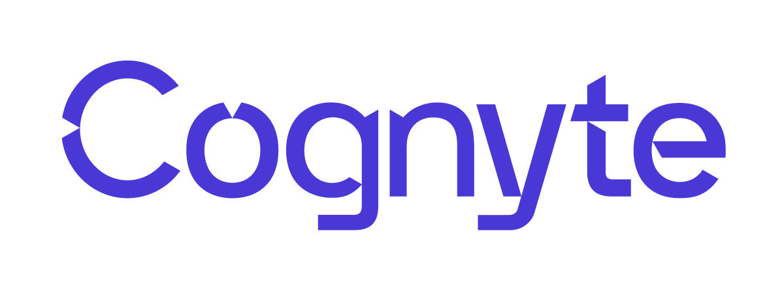
Top Cloud Attacks in Last years
Cognyte is a company that provides security software solutions and cyber analytics. The company had an unsecured database in May of 2021. The culprits managed to expose 5 billion records. Information such as names, email addresses, passwords, and vulnerability data points within their system was leaked.

Slide 18
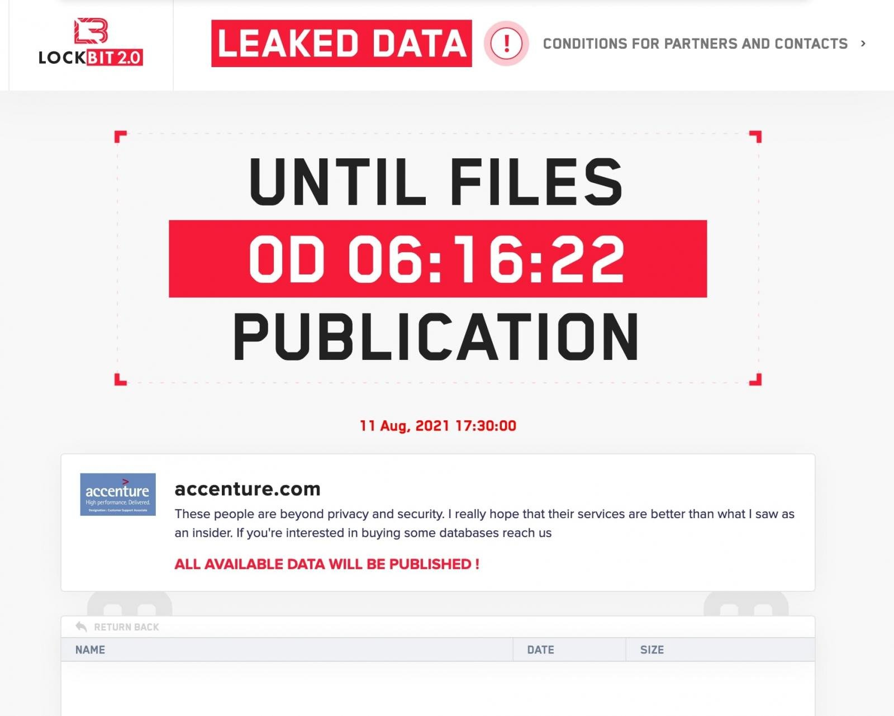
Top Cloud Attacks in Last years
Accenture is one of the biggest information technology services and consulting company. Accenture had a LockBit ransomware attack in August of 2021. The culprits claimed to have stolen 6TB worth of data, for which they requested a ransom of $50 million.

Slide 19
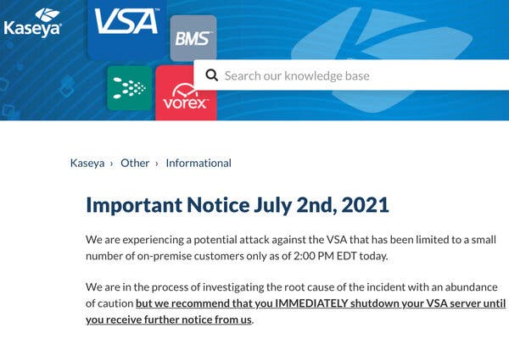
Top Cloud Attacks in Last years
Kaseya is a software company that develops software for managing networks, systems, and information technology infrastructure. In July of 2021, IT solutions provider Kaseya identified an attack on their unified remote monitoring and network perimeter security tool. The attackers aimed to steal administrative control for Kaseya services; from managed service providers to downstream customers. The attack itself disrupted the organization’s SaaS servers and affected on-premise VSA solutions used by Kaseya customers across nearly a dozen countries.

Slide 20

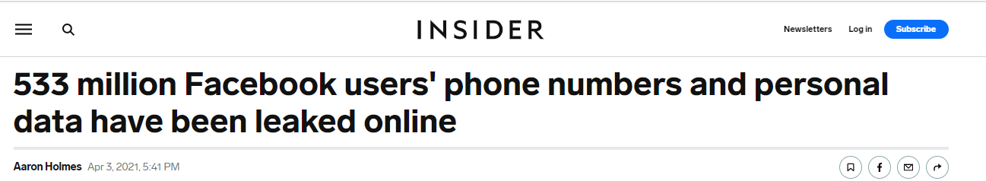
Top Cloud Attacks in Last years
Facebook is an online social media platform with around 2 billion daily users. They reported a breach affecting over 533 million user records, which were publicly exposed on Amazon’s cloud computing service in April of 2021.

Slide 21
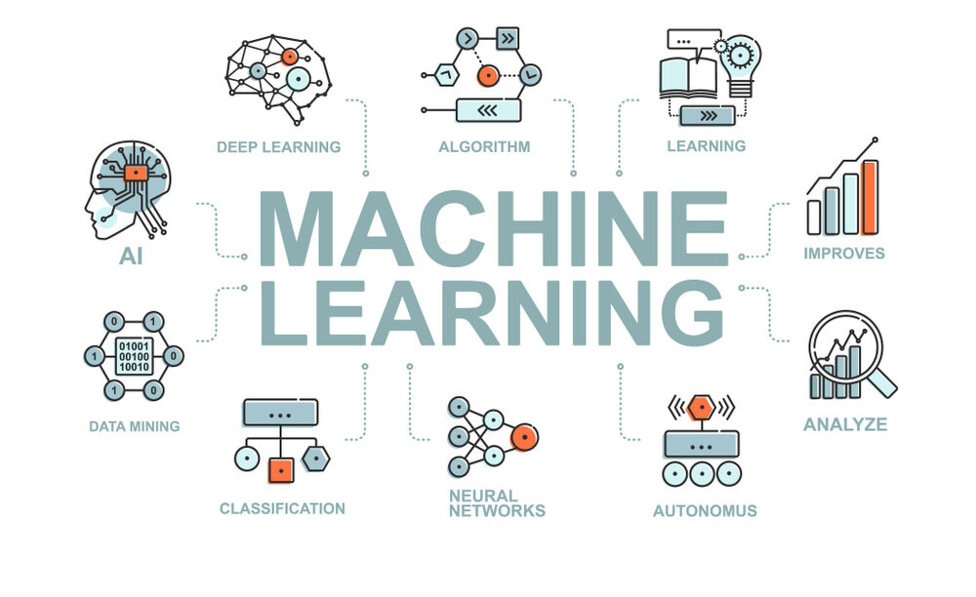
Machine Learning Solutions for Cloud Security
Machine learning is a branch of artificial intelligence (AI) and computer science which focuses on the use of data and algorithms to imitate the way that humans learn, gradually improving its accuracy.
Traditional methods for the prevention of threats on the cloud are insufficient due to the increasing number of attacks and attack diversity. Machine learning approaches can offer more responsive and automated security solutions as they handle data more effectively.

Slide 22
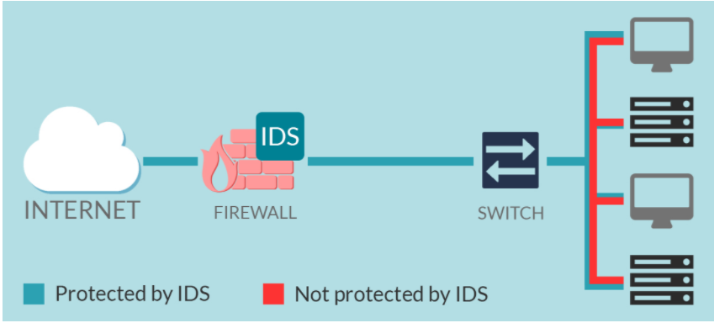
Intrusion Detection Systems (IDS)
Intrusion Detection Systems (IDS) is a cyber security system that works as software or hardware designed to monitor a network and detect vulnerabilities and attacks. IDS use comprehensive approaches to protect the information in cloud applications from attacks.
The IDS system has functions such as detecting the attacks, reporting and recording of these attacks as evidence in the future and quarantining damaged systems.

Slide 23
Intrusion Detection Systems (IDS)
Intrusion Detection System (IDS) has become the most used component of computer system security and compliance practices that defends network accessible Cloud resources and services from various kinds of threats and attacks.
• Network Intrusion Detection System (NIDS)
• Host Intrusion Detection System (HIDS)
• Protocol-based IDS (PIDS)
• Application Protocol-based IDS (APIDS)
• Hybrid Intrusion Detection System

Slide 24
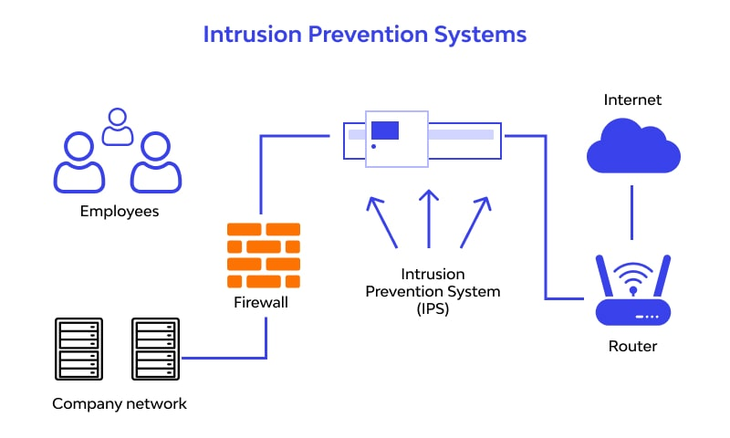
Intrusion Prevention System (IPS)
Intrusion Prevention System (IPS) is a network security tool. This prevention system is generally created behind a firewall and continuously monitors the network for suspicious activities. IPS prevents the attacks from entering the network by examining various data records and prevention the demeanor of the pattern recognition sensor. When an attack is identified, intrusion prevention block and log the offending data.

Slide 25
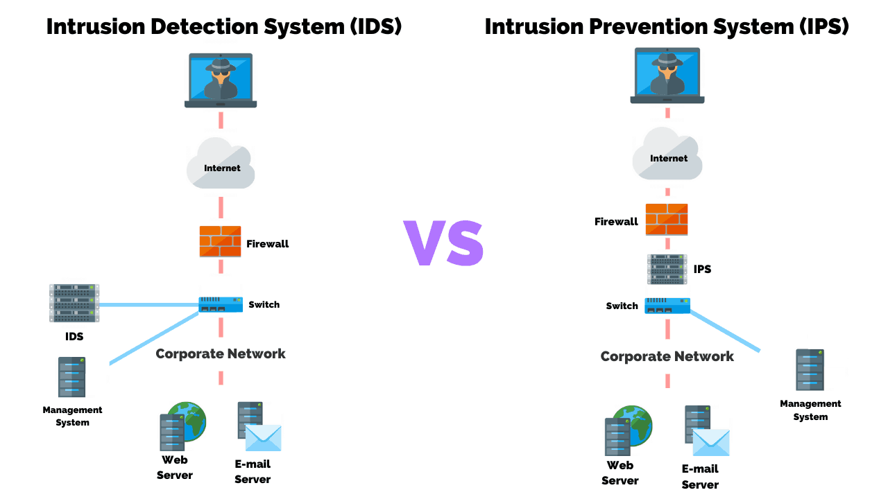
The differences between IDS and IPS
• IPS is set up to take action against attacks, but IDS only works to detect.
• IDS and IPS can work in hardware or software.
• IDS and IPS try to detect attacks by comparing known threats and behavior patterns to their databases.
• IPS takes action on its own but IDS reports to the person who will take action. For this reason, there is a need for personnel who constantly monitor the IDS system.
• Both work by being located behind a firewall.

Slide 26
Thanks for your attention!

